Slide 1

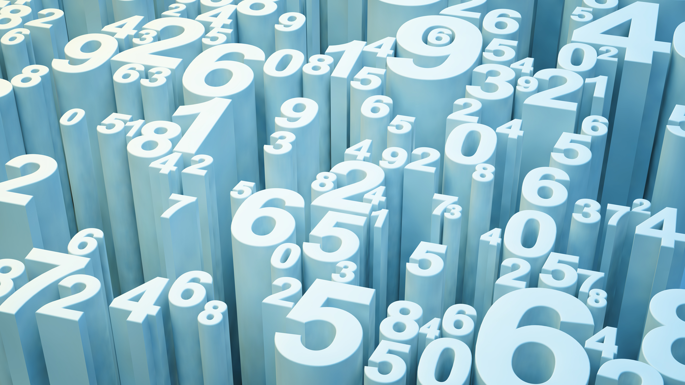

Global Market Performance & Risk Dashboard

Slide 2
Business Objectives
Analyze market performance and volatility trend
For the appropriate level of stakeholders
Identify high-performing and high-risk section:
market trends,
volatility,
and asset class
Support executive decision-making through KPI’s and visualization for fast insights into performance and risk

Slide 3
Requirement Gathering Approach
Business Questions | Technical Concerns
Who is the target audience? | What fields are available?
What business KPIs matter most? | What is the data granularity?
How are KPIs defined and measured? | Are there missing/null data?
Who are the best performers? | What time horizons are available?
Find the most volatile, at-risk segment? | What is the data refresh frequency?
What trends need more attention? | Are there technical/time constraint?

Slide 4

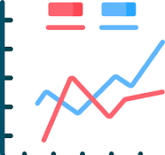
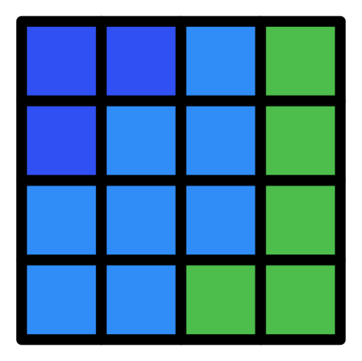

Dashboard Wireframe
Avg Return
Volatility
Risk

Slide 5
Workflow
Raw Dataset
Python
Data Cleaning
Feature Engineer (Returns, Volatility)
Aggregate & Validate
Tableau
Visualization

Slide 6
Validation/Iteration
Review prototype with stakeholders
Confirm KPIs answer business questions
Validate usability and clarity
Iterate based on feedback

